Slide 1
Authentication Applications
support authentication & digital signatures at application-level
Kerberos – a secret key authentication service
X.509 - a public-key directory authentication service
Notes:
This chapter examines some of the authentication functions that have been developed to support application-level authentication and digital signatures.
Will first look at one of the earliest and most widely used services: Kerberos. Then examine the X.509 directory authentication service.

Slide 2
Kerberos
Environment: Open network having many servers and workstations distributed in it; wherein legitimate users of any workstation can access any authorised service from any server.
Problem: How to authenticate users to access services from various servers?
Access can not be based on the workstation, because all users of a workstation need not be legitimate, hence, it should be based on the user.
Notes:
Kerberos is an authentication service developed as part of Project Athena at MIT, and is one of the best known and most widely implemented trusted third party key distribution systems.
Kerberos provides a centralized authentication server whose function is to authenticate users to servers and servers to users. Unlike most other authentication schemes, Kerberos relies exclusively on symmetric encryption, making no use of public-key encryption. Two versions of Kerberos are in common use: v4 & v5.

Slide 3
Is it required to build authentication protocol at each server?
No, use a trusted centralised authentication server called Kerberos.
Kerberos will authenticate users to servers and servers to users.
Kerberos uses symmetric key encryption.
Kerberos’ authentication protocol based on Needham-Schroeder protocol

Slide 4
Kerberos Requirements
Requirements for Kerberos are:
Secure – An eavesdropper should not be able to obtain information necessary to impersonate a user
Reliable – h/w and s/w in kerberos should be reliable, in case of failure, an alternate backup must be available.
Transparent – User should not know anything about the authentication process other than entering password.
Scalable - should support the increase in number of clients and servers.
Notes:
The first published report on Kerberos [STEI88] listed the requirements shown above. To support these requirements, Kerberos is a trusted third-party authentication service that uses a protocol based on that proposed by Needham and Schroeder [NEED78], which was discussed in Chapter 7.

Slide 5
Kerberos v4 Overview
Let Authentication Server (AS) be a trusted 3rd party who has passwords of all users in a secured way
users initially negotiate with AS to identify self
AS provides a non-corruptible authentication credential (ticket granting ticket TGT)
have a Ticket Granting server (TGS)
users subsequently request access to other services from TGS on basis of users TGT
Notes:
The core of Kerberos is the Authentication and Ticket Granting Servers – these are trusted by all users and servers and must be securely administered. The protocol includes a sequence of interactions between the client, AS, TGT and desired server.

Slide 6
Kerberos v4 Dialogue
obtain ticket granting ticket from AS
once per session
obtain service granting ticket from TGS
for each distinct service required
client/server exchange to obtain service
on every service request
Notes:
The full Kerberos v4 authentication dialogue is shown in Stallings Table 14.1, divided into the 3 phases shown above. The justification for each item in the messages is given in Stallings Table 14.2.

Slide 7
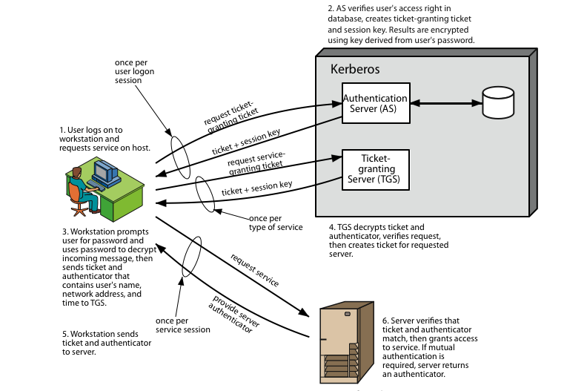
Kerberos 4 Overview
Notes:
Stallings Figure 14.1 diagrammatically summarizes the Kerberos v4 authentication dialogue, with 3 pairs of messages, for each phase listed previously.

Slide 8
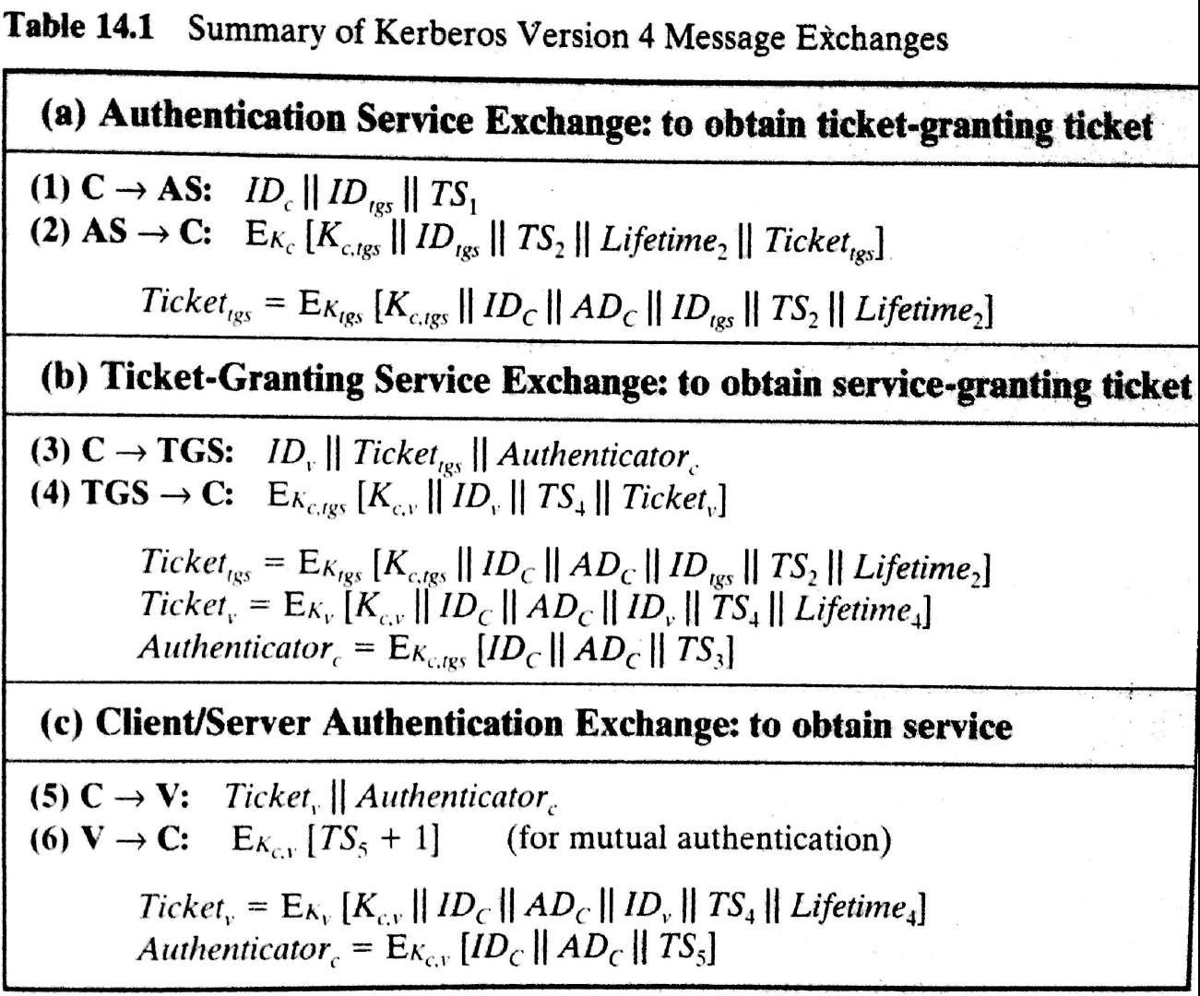

Slide 9
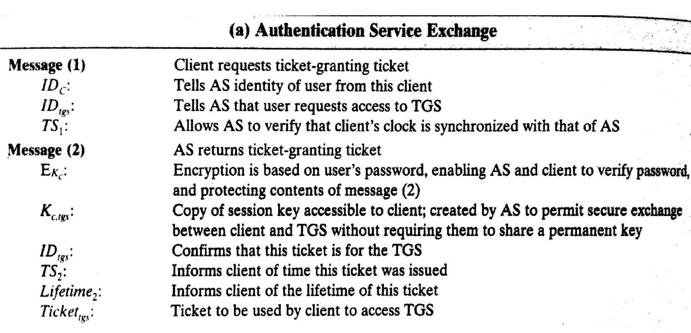

Slide 10
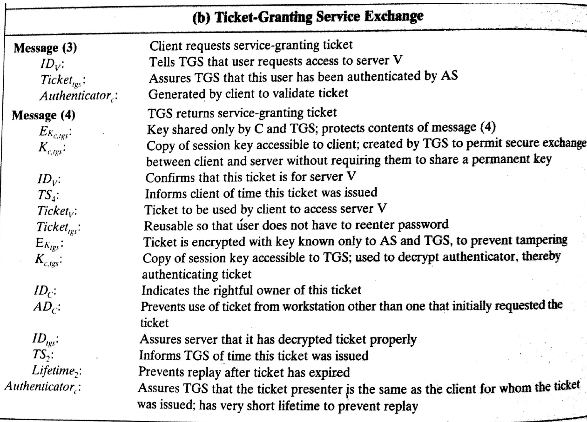

Slide 11
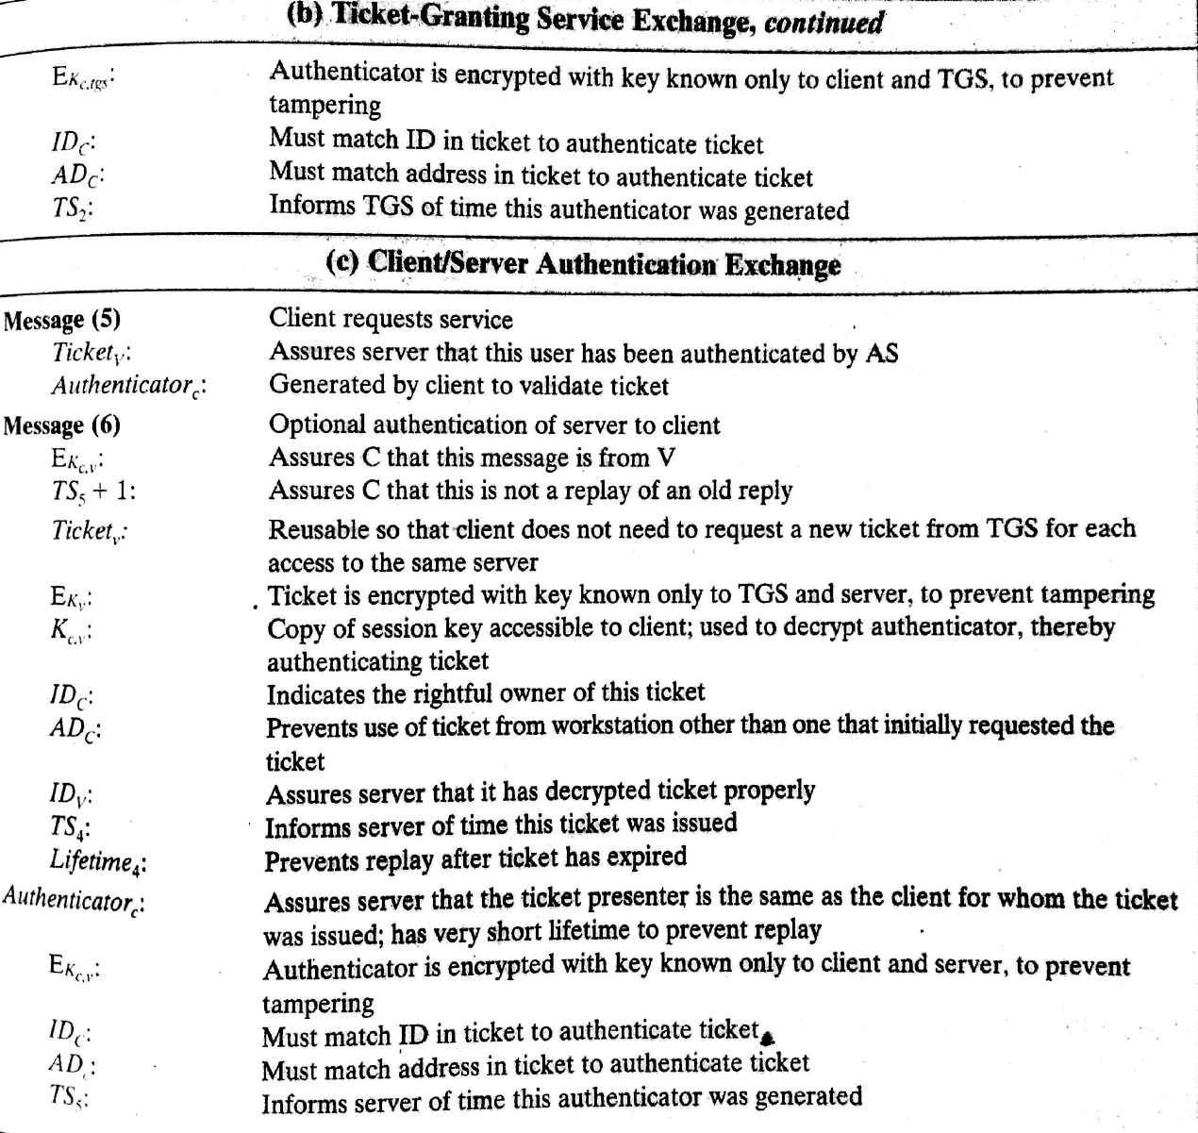

Slide 12
Kerberos Realms
a Kerberos environment consists of:
a Kerberos server
a number of clients, all registered with server
application servers, sharing keys with server
this is termed a realm
typically a single administrative domain
if have multiple realms, their Kerberos servers must share keys and trust
Notes:
A full-service Kerberos environment consisting of a Kerberos server, a number of clients, and a number of application servers is referred to as a Kerberos realm. A Kerberos realm is a set of managed nodes that share the same Kerberos database, and are part of the same administrative domain. If have multiple realms, their Kerberos servers must share keys and trust each other.

Slide 13
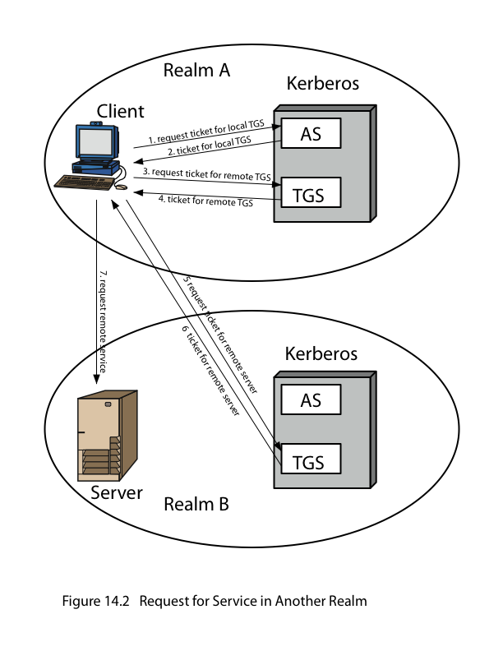
Kerberos Realms
Notes:
Stallings Figure 14.2 shows the authentication messages where service is being requested from another domain. The ticket presented to the remote server indicates the realm in which the user was originally authenticated. The server chooses whether to honor the remote request. One problem presented by the foregoing approach is that it does not scale well to many realms, as each pair of realms need to share a key.

Slide 14
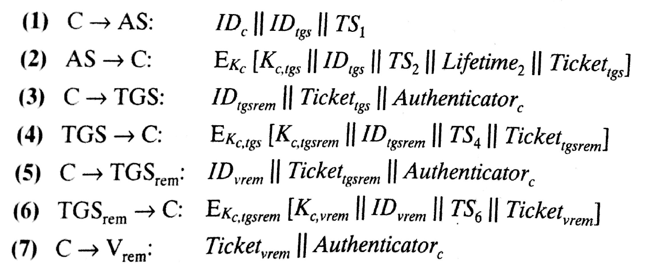

Slide 15
Kerberos Version 5
developed in mid 1990’s
specified as Internet standard RFC 1510
provides improvements over v4
addresses environmental shortcomings
encryption alg, network protocol, byte order, ticket lifetime, authentication forwarding, interrealm auth
and technical deficiencies
double encryption, non-std mode of use, session keys, password attacks
Notes:
Kerberos Version 5 is specified in RFC 1510 and provides a number of improvements over version 4 in the areas of environmental shortcomings and technical deficiencies, in areas as noted. See Stallings Table 14.3 for details of the Kerberos v5 authentication dialogue.

Slide 16
